Slide 1
Palm Bay Stake Coordination
November 2024

Slide 2
Stake Role
President Smith holds the keys in the stake for sharing the gospel and strengthening new and returning members. He and his counselors give overall direction for these efforts. He ensures that this work is discussed regularly in stake meetings.
Monthly coordination meetings between Stake and Mission President
Role of Stake High Council and Stake Relief Society Presidency is to “instruct and support” in group settings and individually
  Leader training

Slide 3
Stake Missionary Vision
Turn every missionary referral into a member referral
Members having sacred missionary experiences
Weekly ward missionary coordination “huddle”

Slide 4
Ward Role in Missionary Work
Bishop
Youth
Elders Quorum Presidency
Relief Society Presidency
Common Judge
Poor and Needy
Ministering
Financesand Temporal Affairs
Temple
Family History
Missionary Work
Teaching

Slide 5
Every Missionary Referral is a Member Referral
Lessons with members present
Members befriending missionary friends at church and guide through church services
Members invite missionary friends to dinner

Slide 6
Members Sacred Missionary Experiences
Work with missionaries with fellowshipping
Take longer term view with member and full-time missionary partnership working together
Love, Share, and Invite in ways that feel natural
Become familiar with Sharing the Gospel Section in Gospel Library App

Slide 7
Weekly Ward Missionary Coordination “Huddle”
Every Week! In person or remote
Brief and Informal – assignment driven
Strive for complete “Team” attendance
Ensure ALL are involved
Strive for unity and love

Slide 8
Weekly Missionary “Huddle”
10 min or less!
EPQ/RSP/WML can take turns conducting
Use My Covenant Path App – missionaries keep updated
Ask two questions during each huddle:
  What new convert missed church and who will visit them?
  Who is the missionaries teaching and can we help?

Slide 9
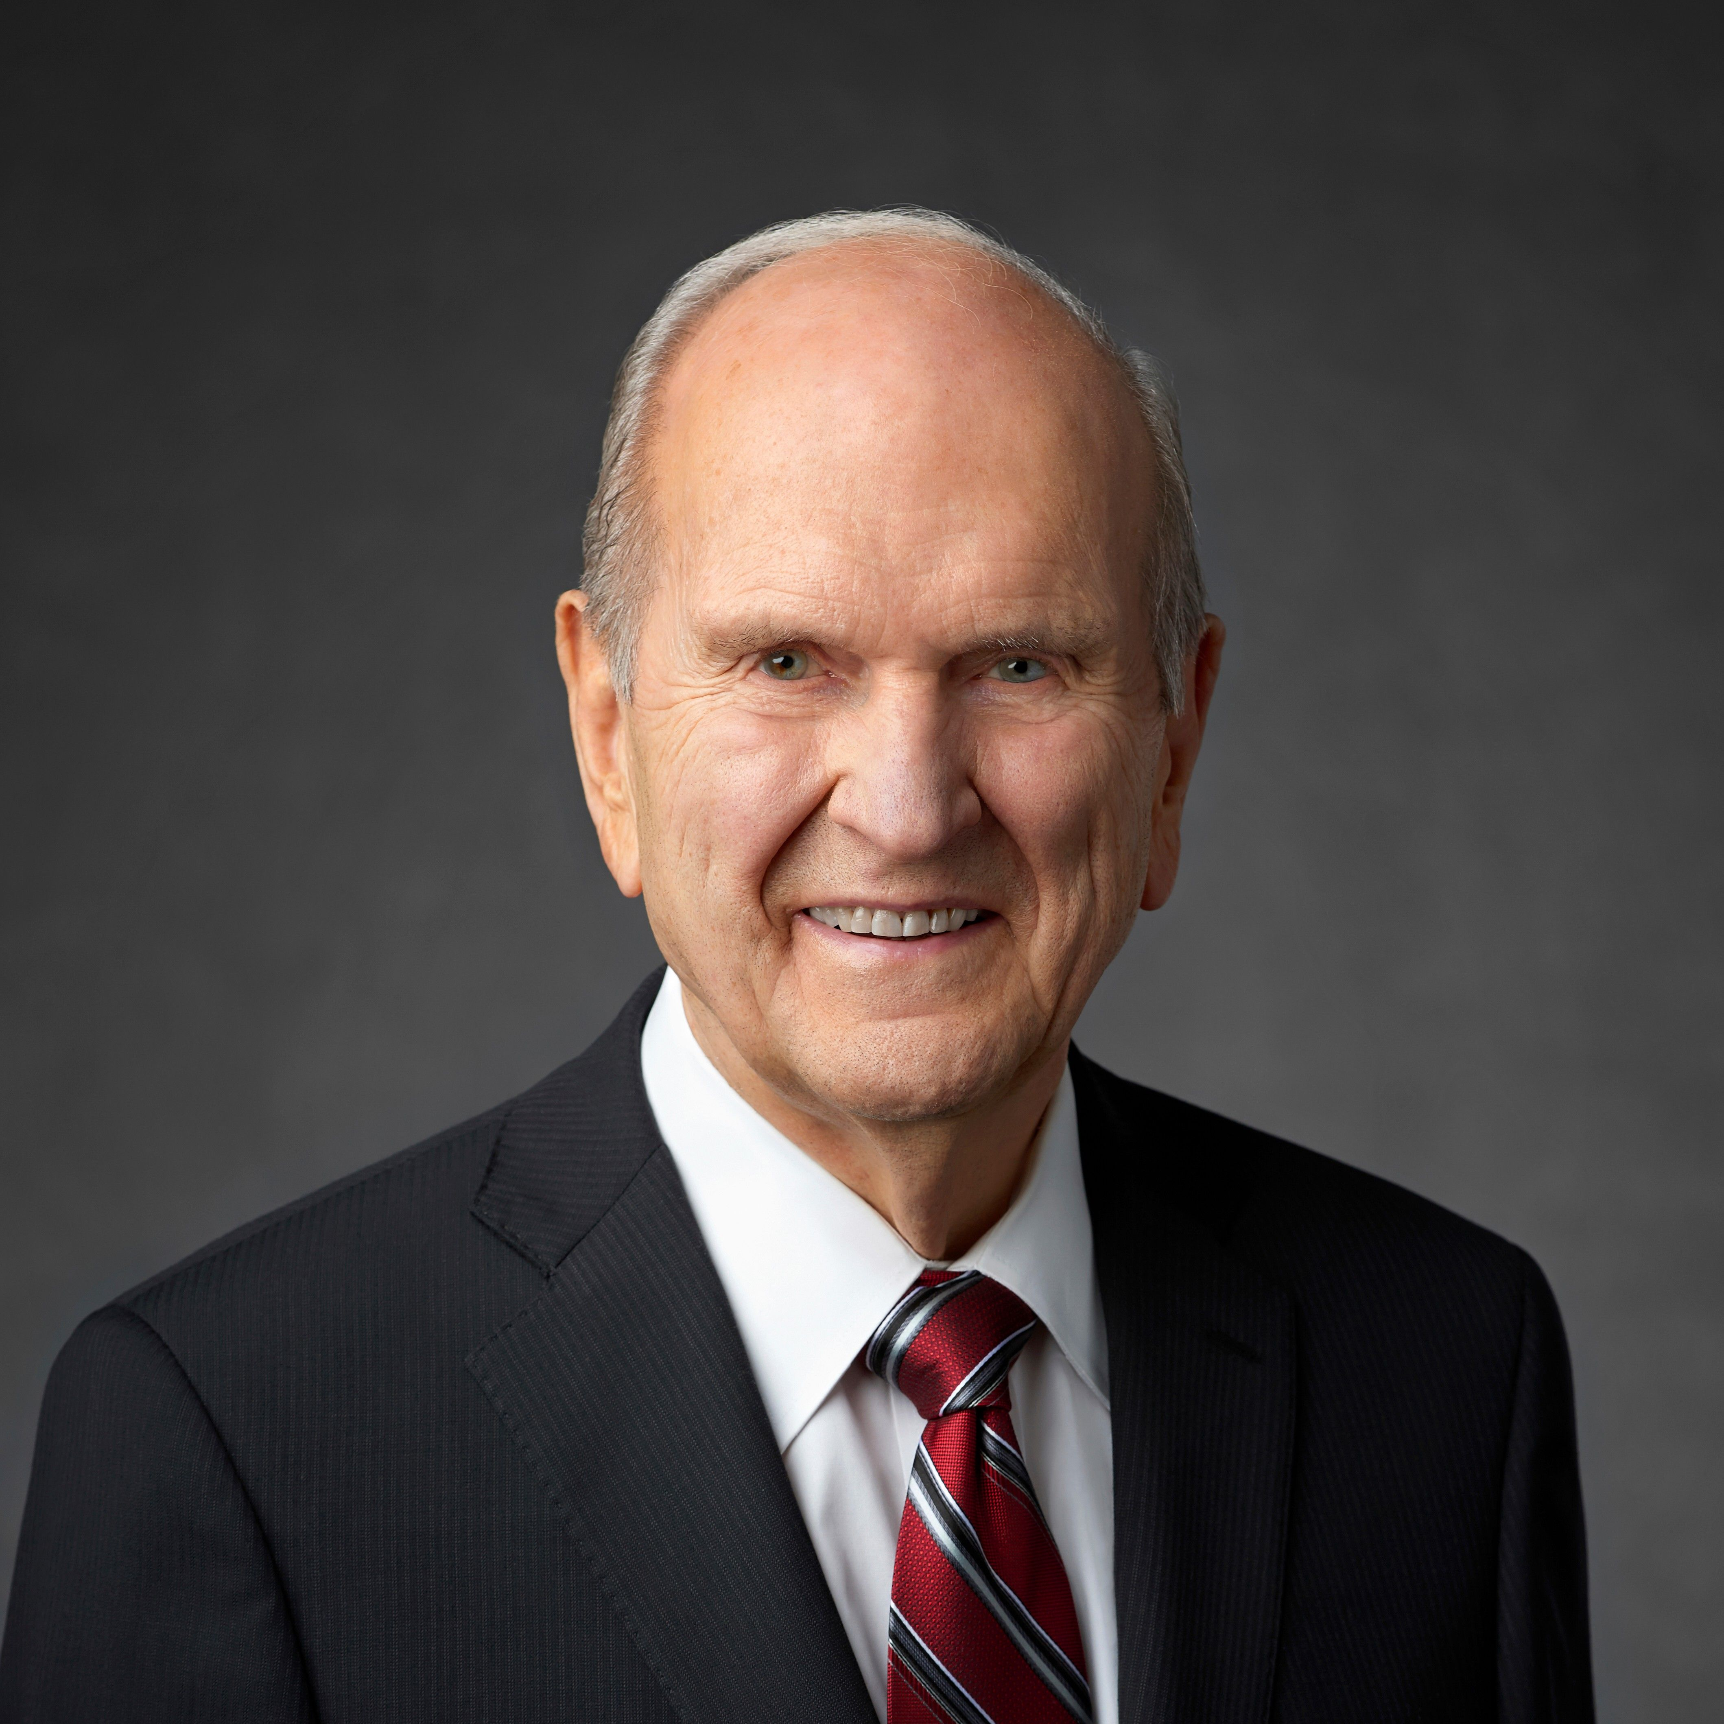
Words From the Lord’s Prophet
“These surely are the latter days, and the Lord is hastening His work to gather Israel. That gathering is the most important thing taking place on earth today. Nothing else compares in magnitude, nothing else compares in importance, nothing else compares in majesty.”

Slide 10
Words from the Lord’s Prophet
“We live in the day that “our forefathers have awaited with anxious expectation. "We have front-row seats to witness live what the prophet Nephi saw only in vision, that “the power of the Lamb of God” would descend “upon the covenant people of the Lord, who were scattered upon all the face of the earth; and they were armed with righteousness and with the power of God in great glory.”
You, my brothers and sisters, are among those men, women, and children whom Nephi saw. Think of that!”

